Slide 1
Proctoring Computerized Math MCA-II

Slide 2
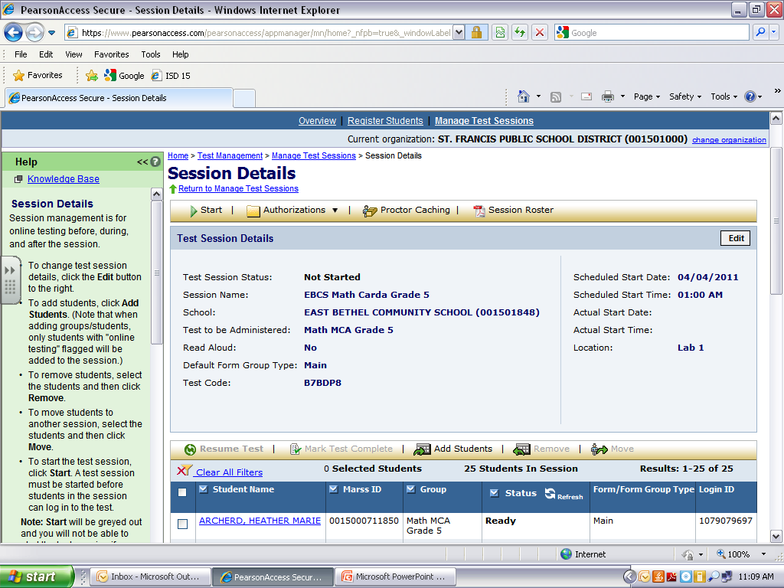
Testing Screen

Slide 3
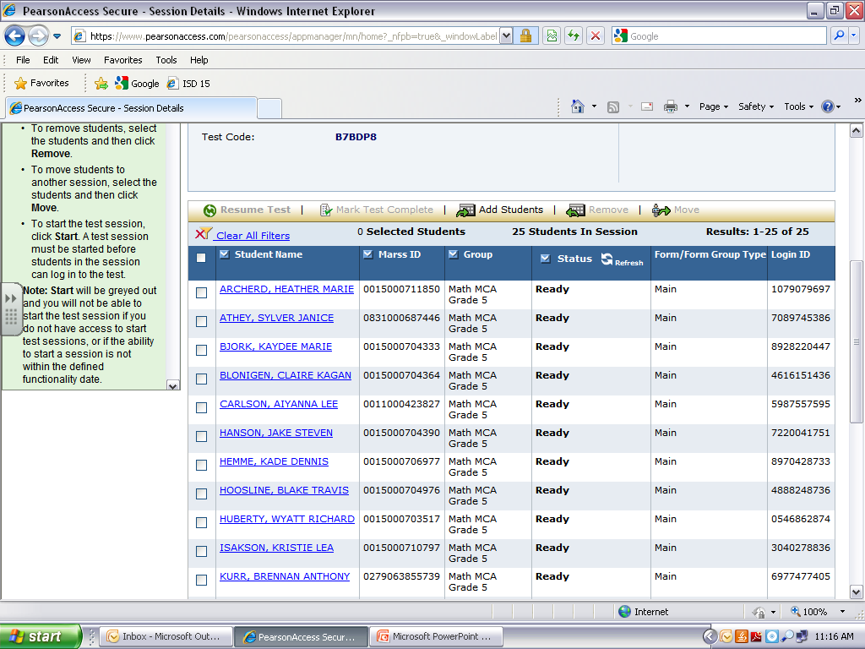
The status column allows you to check progress. The test below has not yet been started. If students are testing it will say active in the status column.

Slide 4
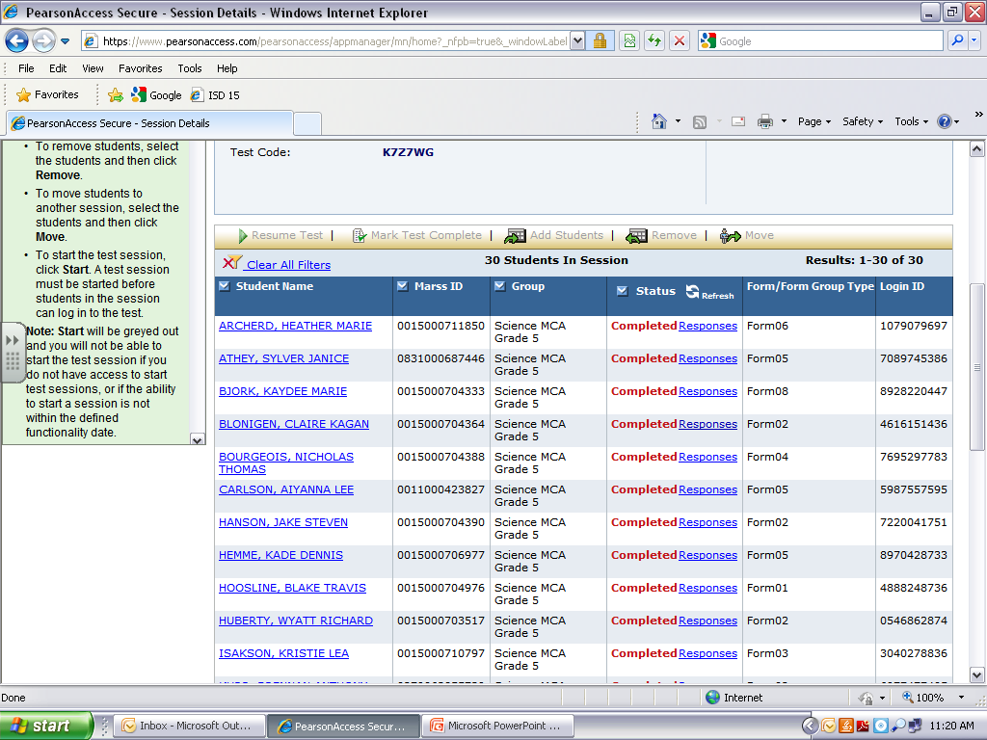
All students who are finished testing should say complete. If not, then their answers were not submitted properly.

Slide 5
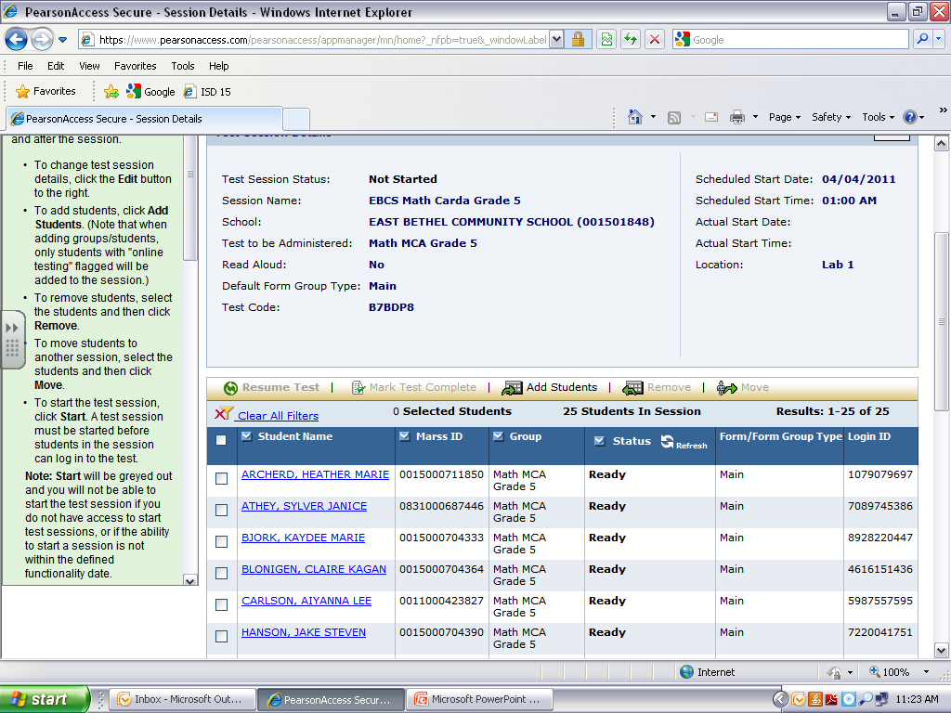
If students are having trouble starting the test, you may need to resume their test. Check the box next to students who are having issues then click resume test. It will then have you confirm, click yes.

Slide 6
As students finish you may want to refresh your screen to be sure their status has been updated to complete. There are two places you can click to refresh your screen. See the arrows below.

Slide 7
Reminders
Students will begin by entering their User ID and Password. The screen will be ready for them to do so.
You can pick up student authorization tickets from Michelle in the office on your first day of testing. User IDs and Passwords will be highlighted for them.
Remember to collect the authorization tickets each testing session. You can keep them for the week of testing, but please put them in a SAFE place.
When students are finished testing for the day they can click the red x in the upper right-hand corner to end their session. They should NOT click the red x for any other purpose.
Please provide your students with blank paper for the test. They must write their name on them. Collect the papers each day and keep them in a safe place.
Authorization tickets and all scratch paper must be turned in after your last testing session to ensure proper disposal.
*NO snacks will be provided for math MCA testing.

